Slide 1
Welcome!
Grand Rounds After Hours: Disability Insurance
Academy of Medicine of Cincinnati
April 9, 2024
t

Slide 2
Welcome!
Grand Rounds After Hours: Disability Insurance
Academy of Medicine of Cincinnati
April 9, 2024

Slide 3
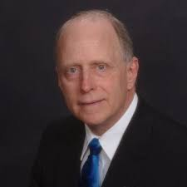
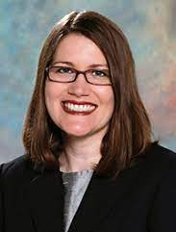
Panelists
Joseph S. Cheng, MD, MS
2024-2025 AOMC President
Associate Director for UC Gardner Neuroscience Institute,
Frank H. Mayfield Endowed Chair, & Professor,
Deptartment of Neurosurgery, UC College of Medicine
Steve R. Feagins, MD, MBA
AOMC Education Committee Chair
VP, Medical Affairs & Designated
Institutional Official (ACGME), Mercy Health
Jeff Mohr, RHU, CLTC
Chief Executive Officer
Diversified Brokerage Specialists
Rebecca W. Short, MD
AOMC Community Outreach Chair
Dermatology, Group Health,
Trihealth Physician Partners

Slide 4
Your Questions
.
Should one buy Disability insurance during residency/ fellowship?
How does it differ from the "basic" insurance that my institution provides?
What’s a “good” annual rate to pay?
How much coverage to have (does it matter based on subspecialty)?
Prior conditions, how that changes insurance shopping, what carriers still accept?
Best options for non-surgical residents?
How to choose an insurance company and what to ask when choosing a plan?
www.reallygreatsite.com

Slide 5
What You Have Now vs. Individual Coverage
Group Long-Term Disability Insurance
Typically paid by your employer
Covers a percentage of your base salary for as long as you remain in your position
Typically have significant limitations on what they cover
Typically not portable
If your employer pays for the policy, the benefit comes to you as taxable income
Can be more challenging to qualify for benefits
Restrictions on Mental/Nervous Condition Benefits
Rehabilitation Contingencies
Private Individual Disability Insurance
Obtained by and paid for by you
Offers the most comprehensive coverage with the strongest language.
Stays with you throughout your career
Tailored to your needs and can take into account all sources of income
The policy’s benefit is tax-free
Riders, or building blocks of the policy, create the total package tailored to your needs.
Notes:
Qualifying for Long-Term Disability (LTD): Broad non-specific language and definitions make it difficult to qualify for or remained qualified for benefits given doctor’s and dentist’s education and skills. Example language, “Own Occupation AND Not Working AND Not Engaged in Any Activity for which Any Other Individual Receives Compensation” This ‘definition’ gets boiled down when presented to the residents as “Own Occupation AND some other stuff” Thus, it is a ‘sold’ as an own occupation policy BUT you must be not working either as a physician or anything else AND you must do NOTHING with your time… So, if you cannot perform the duties of your occupation AND you cannot or do not work AND you do nothing anyone else gets paid for THEN you qualify for the benefit… and then the benefit gets taxed. Does that sound like what a physician or dentist is going to do if disabled?
Mental/Nervous Condition Benefit Restrictions: They are capped. Twenty-Four (24) months of benefits is all you will receive. Mental/Nervous disorders and Substance Abuse are both generally capped in ALL Group Policies, even the best ones on the market. The percentage of Mental/Nervous claims has been increasing over the past 20 years. Recall that group policies MUST cover all comers, thus companies must restrict the potential benefit for these conditions. Carriers may require certain treatments for Mental/Nervous Disorders and Substance Abuse in order to keep receiving the benefit. Insidiously, some group policies will have language that allow the carriers to pick and choose for which condition(s) a claimant is receiving a benefit. Example: A 45 year old physician with POTS syndrome first diagnosed at age 42 had been also having panic attacks for a few years prior to diagnosis when his heart rate would drop below 20 beats per minute (you would too, have a panic attack, trust me) thus the doctor somehow was labeled PTSD in his medical record for repeated panic attacks. Almost dying several times a year may cause some psychological trauma. For which aliment do you think the group LTD policy wants to pay benefits? That’s right, the PTSD because they only pay for two years and they are done.
Rehabilitation Contingencies: These provisions make receiving the benefit contingent on participation and completion of ALL the assigned rehabilitation treatments. Assigned by Whom? You guessed it, the insurance carrier. They will deem necessary rehabilitation treatments for the disabled physician or dentist and NOT allow the disabled medical professional whom well knows what treatments are needed to get back to work to make the decisions on their own care with their own doctors. Remember the young claims specialist who may or may not even have a college degree? That’s the person overseeing your rehabilitation plan for the group disability insurance carrier. Did I mention that employment turnover rate for the position of claims specialist may be rapid and occur more than once a year?
Self-Reported Symptoms: My personal favorite among the group disability policy language are sections that deal with benefits being reduced for self-reported symptoms. While I understand why this would be in a policy that covers everyone employed at a large university and hospital system; does it really make sense for the person that went to medical school or dental school for that matter? Believe it or not, a doctor or dentist self-reporting symptoms can interfere with their ability to receive benefits in some group disability insurance plans.

Slide 6
Terms to Know
Riders: These are the building blocks of a policy. Allow you to create the total package tailored to your needs.
Own Occupation/Specialty Specific: This language means if you cannot perform what you were specifically educated and trained to perform, you qualify as disabled and are therefore entitled to receive benefits regardless of whether you are employed in another occupation.
Future Purchase Option: It allows you to increase your coverage as your salary increases or you change jobs with different benefits without having to undergo additional medical underwriting.
Residual or Partial Disability: This benefit provides for circumstances that cause you to work part-time because of injury or illness. When you have lost a certain percentage of your income, time, or duties (depending on your policy), a benefit will be triggered.
Cost of Living Adjustment (COLA): This rider, also known as the COLA rider, helps offset the risk of inflation. On the anniversary of your claim, the carrier increases your monthly benefit based on the language in your policy.
Notes:
Own occupation: This is the most important piece of the policy. There are several terms used to mean your “own occupation.” Some carriers have it built in, whereas others will make you add it as a rider.
Future purchase option: This rider is an absolute must for young practitioners to protect their future earning potential. This rider also goes by many different terms.
Residual or Partial disability: Each year, more partial disability claims are filed and paid than total disability claims.
The COLA can have simple or compound interest moving forward. Benefits range from up to 3 to 6 percent of the monthly benefit. Some carriers have a fixed percentage increase, while others are tied to the Consumer Price Index and therefore have a range.
Catastrophic Injury Rider: (also known as the CAT rider)

Slide 7
Terms to Know
Catastrophic Injury Rider: This rider offers extra protection—in addition to a standard monthly benefit—from the financial impact of a more serious injury or illness. For most individual policies, if you are unable to perform two or more of your activities of daily living or are severely cognitively impaired, you would qualify for an additional benefit.
Non-Cancellable, Guaranteed Renewable: This means that the insurance carrier cannot cancel, increase the premiums, or add restrictions to your policy once they have made an offer and you pay the premiums. Even if they stop offering the type of policy you own, as long as you continue to pay your premiums you will receive the same coverage.
Benefit Period: This is the length of time that your claim would be paid. Carriers typically offer options that will pay out until the insured turns 65 to 70 years of age.
Elimination/Waiting Period: This is the time between something happening to you and you getting paid. The most common length is 90 days; however, there are shorter and longer options available.
Notes:
Own occupation: This is the most important piece of the policy. There are several terms used to mean your “own occupation.” Some carriers have it built in, whereas others will make you add it as a rider.
Future purchase option: This rider is an absolute must for young practitioners to protect their future earning potential. This rider also goes by many different terms.
Residual or Partial disability: Each year, more partial disability claims are filed and paid than total disability claims.
The COLA can have simple or compound interest moving forward. Benefits range from up to 3 to 6 percent of the monthly benefit. Some carriers have a fixed percentage increase, while others are tied to the Consumer Price Index and therefore have a range.
Catastrophic Injury Rider: (also known as the CAT rider)

Slide 8
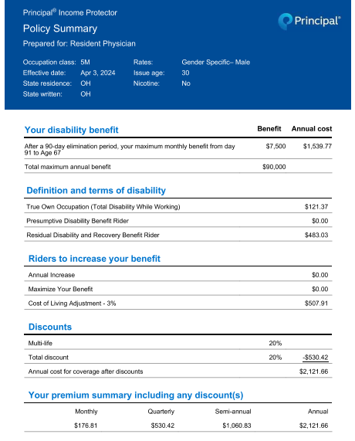
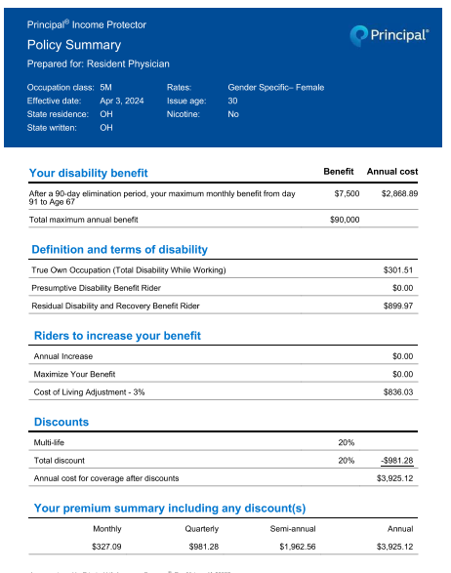
Sample Individual Policies for Residents

Slide 9
Other Considerations
Specialty type, surgical vs. non-surgical, etc.
Mental health conditions
Adding life insurance
Coverage for Family Care
Student Loan Rider
Notes:
Pause here for other questions

Slide 10
Top Tips
1. Act NOW while young
The younger you are, the cheaper the policy
Build in coverage while healthy
Larger benefit to income ratio
2. Really UNDERSTAND:
The Own Occupation Provision and the specific language in the policy you choose to purchase.
Future Purchase or Future Increase Options for the policies you compare.
The Riders that are offered like Residual Riders, Recovery Riders and Cost of Living Adjustment Riders
3. Pay with post tax dollar from a checking account with your name on it. (ALWAYS)
4. Work with an independent insurance broker

Slide 11
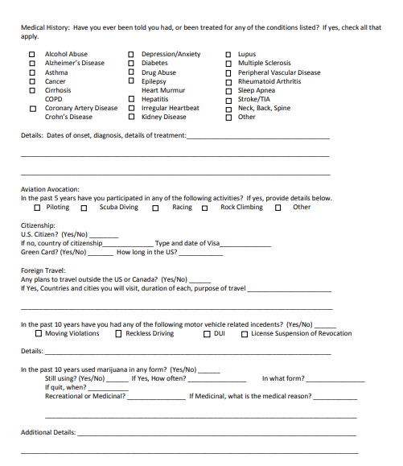
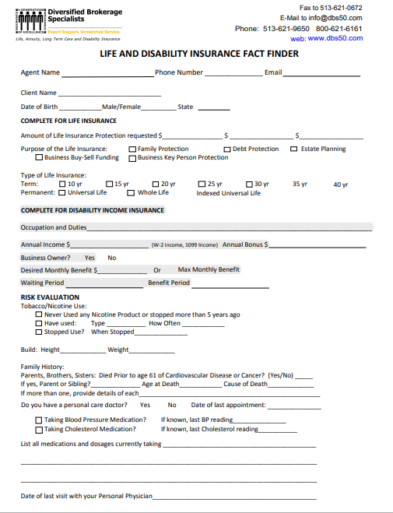
Now What?
Get Started
1. Contact an Independent Broker
Diversified Brokerage Specialists:
Expertise in working with physicians
Highly qualified/long tenure
Will shop for you/not tied to specific carrier
Discounts for Academy Members (membership is free for Residents)
2. How the process works

Slide 12
Thank You
Academy of Medicine of Cincinnati

